Slide 1
Case Report
Dr Malek Alhamidi Dr Fatima Aljojo

Slide 2
a 26 y woman who presented to us with a history of dyspnea,
lower back pain and fatigue for two months.

Slide 3
a 26 y woman who presented to us with a history of dyspnea,
lower back pain and fatigue for two months.
No fever, no cough, no lose weight .

Slide 4
a 26 y woman who presented to us with a history of dyspnea,
lower back pain and fatigue for two months.
No fever, no cough, no lose weight .
Past medical history: The woman is previously healthy.

Slide 5
a 26 y woman who presented to us with a history of dyspnea,
lower back pain and fatigue for two months.
No fever, no cough, no lose weight .
Past medical history: The woman is previously healthy.
Never admitted to the hospital. Not taking any medication.
Her past surgical history is negative.
Her family history is negative.

Slide 6
Physical exam:
She was vitally stable, no hypertension, no fever, normal saturation on room air.

Slide 7
Physical exam:
She was vitally stable, no hypertension, no fever, normal saturation on room air.
Able to speak full sentences.

Slide 8
Physical exam:
She was vitally stable, no hypertension, no fever, normal saturation on room air.
Able to speak full sentences.
Lung exam : decreased air entry of the right side .
Abdomen : no organomegaly .

Slide 9
Imaging
her PA chest X ray showed diffuse opacity of the right lung field and air fluid level on the left side suggesting: both right and left sided pleural effusion.

Slide 10
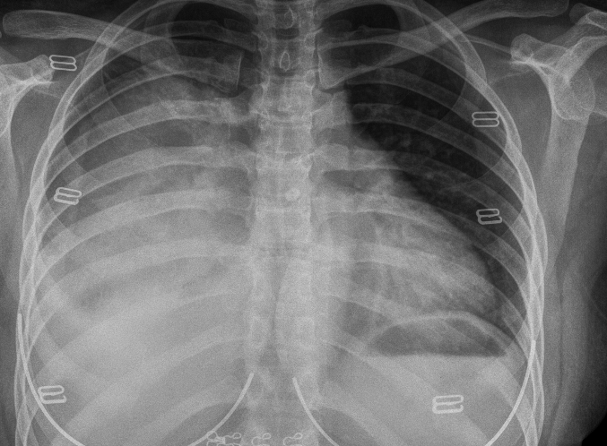
7 /9 /2019

Slide 11
further imaging including CT scan showed:
Big mediastinal mass , right pleural effusion ,eight thoracic vertebrae compression .

Slide 12
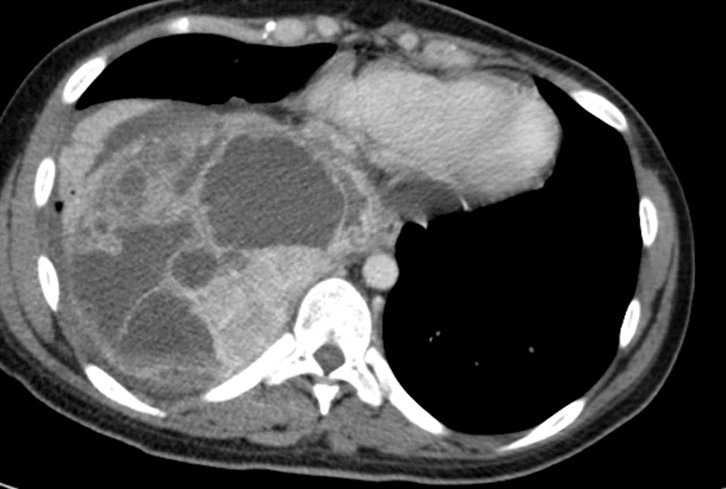
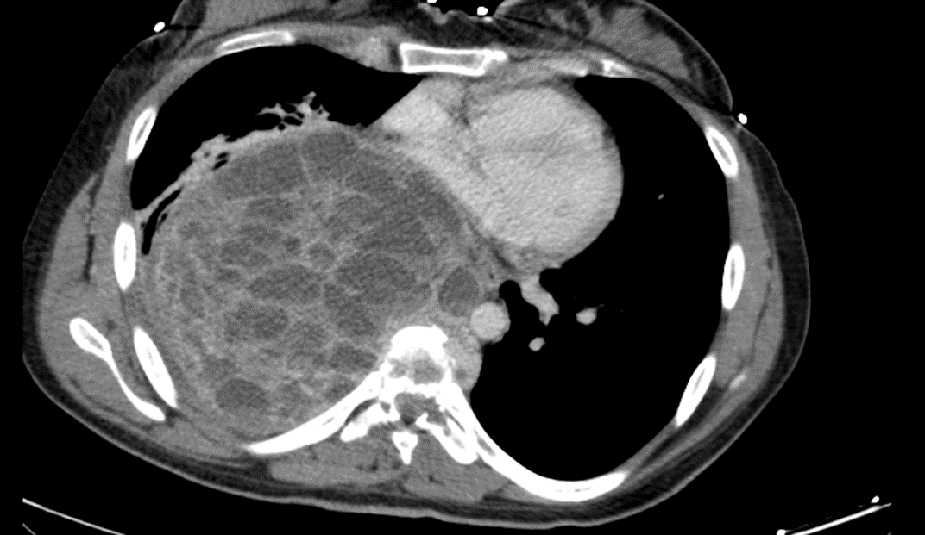
7 /9 /2019

Slide 13
7 /9 /2019

Slide 14
The differential diagnosis of an anterior mediastinal mass :
Thymoma
Germ cell tumer
Lymphoma
Small cell carcinoma
Sarcoma (rare)

Slide 15
The girl underwent CT guided needle biopsy.

Slide 16
The girl underwent CT guided needle biopsy.
Pathology report showed : Giant cell tumer.

Slide 17
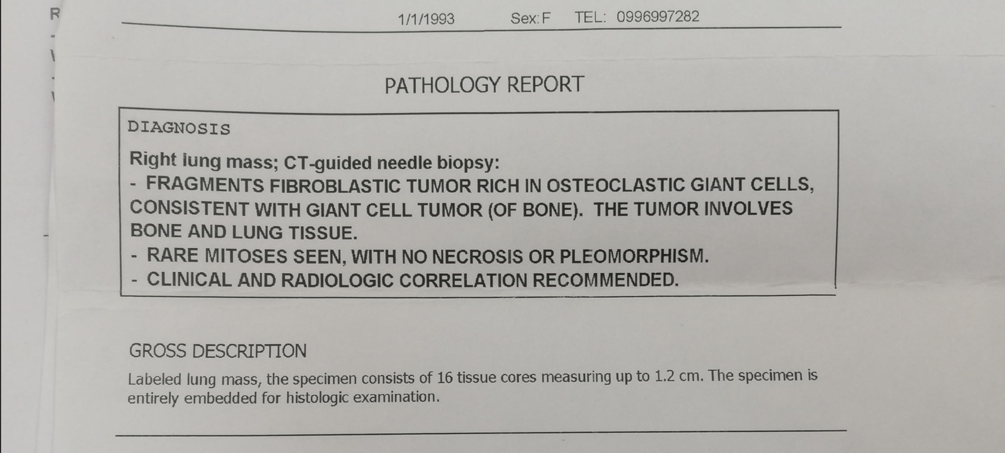
9/9/2019

Slide 20
MRI thorax with contrast:
Thoracic vertebral interval T 7-8: nearly complete destruction of T8 body with contrast enhancing infiltration extending to the pedicle and the adjacent spinal canal.
A heterogeneous, contrast enhancing cystic giant mass measuring 12x12 cm.

Slide 21
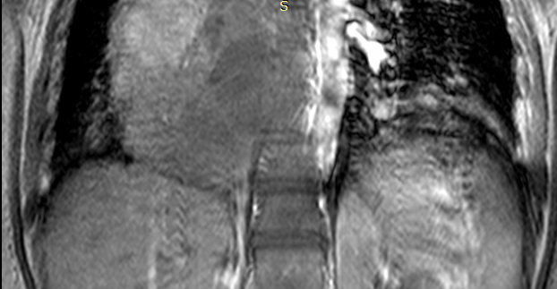
MRI 21/10/2019

Slide 22
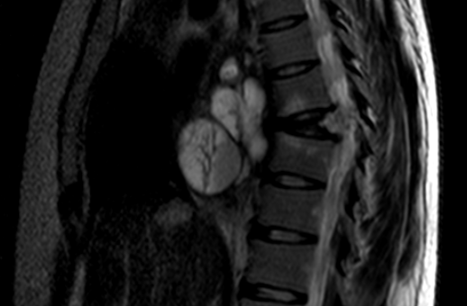
MRI 21/10/2019

Slide 23
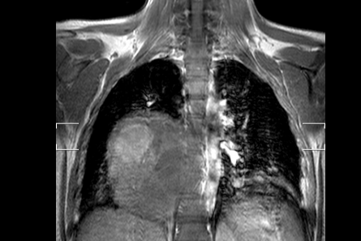
MRI 21/10/2019

Slide 24
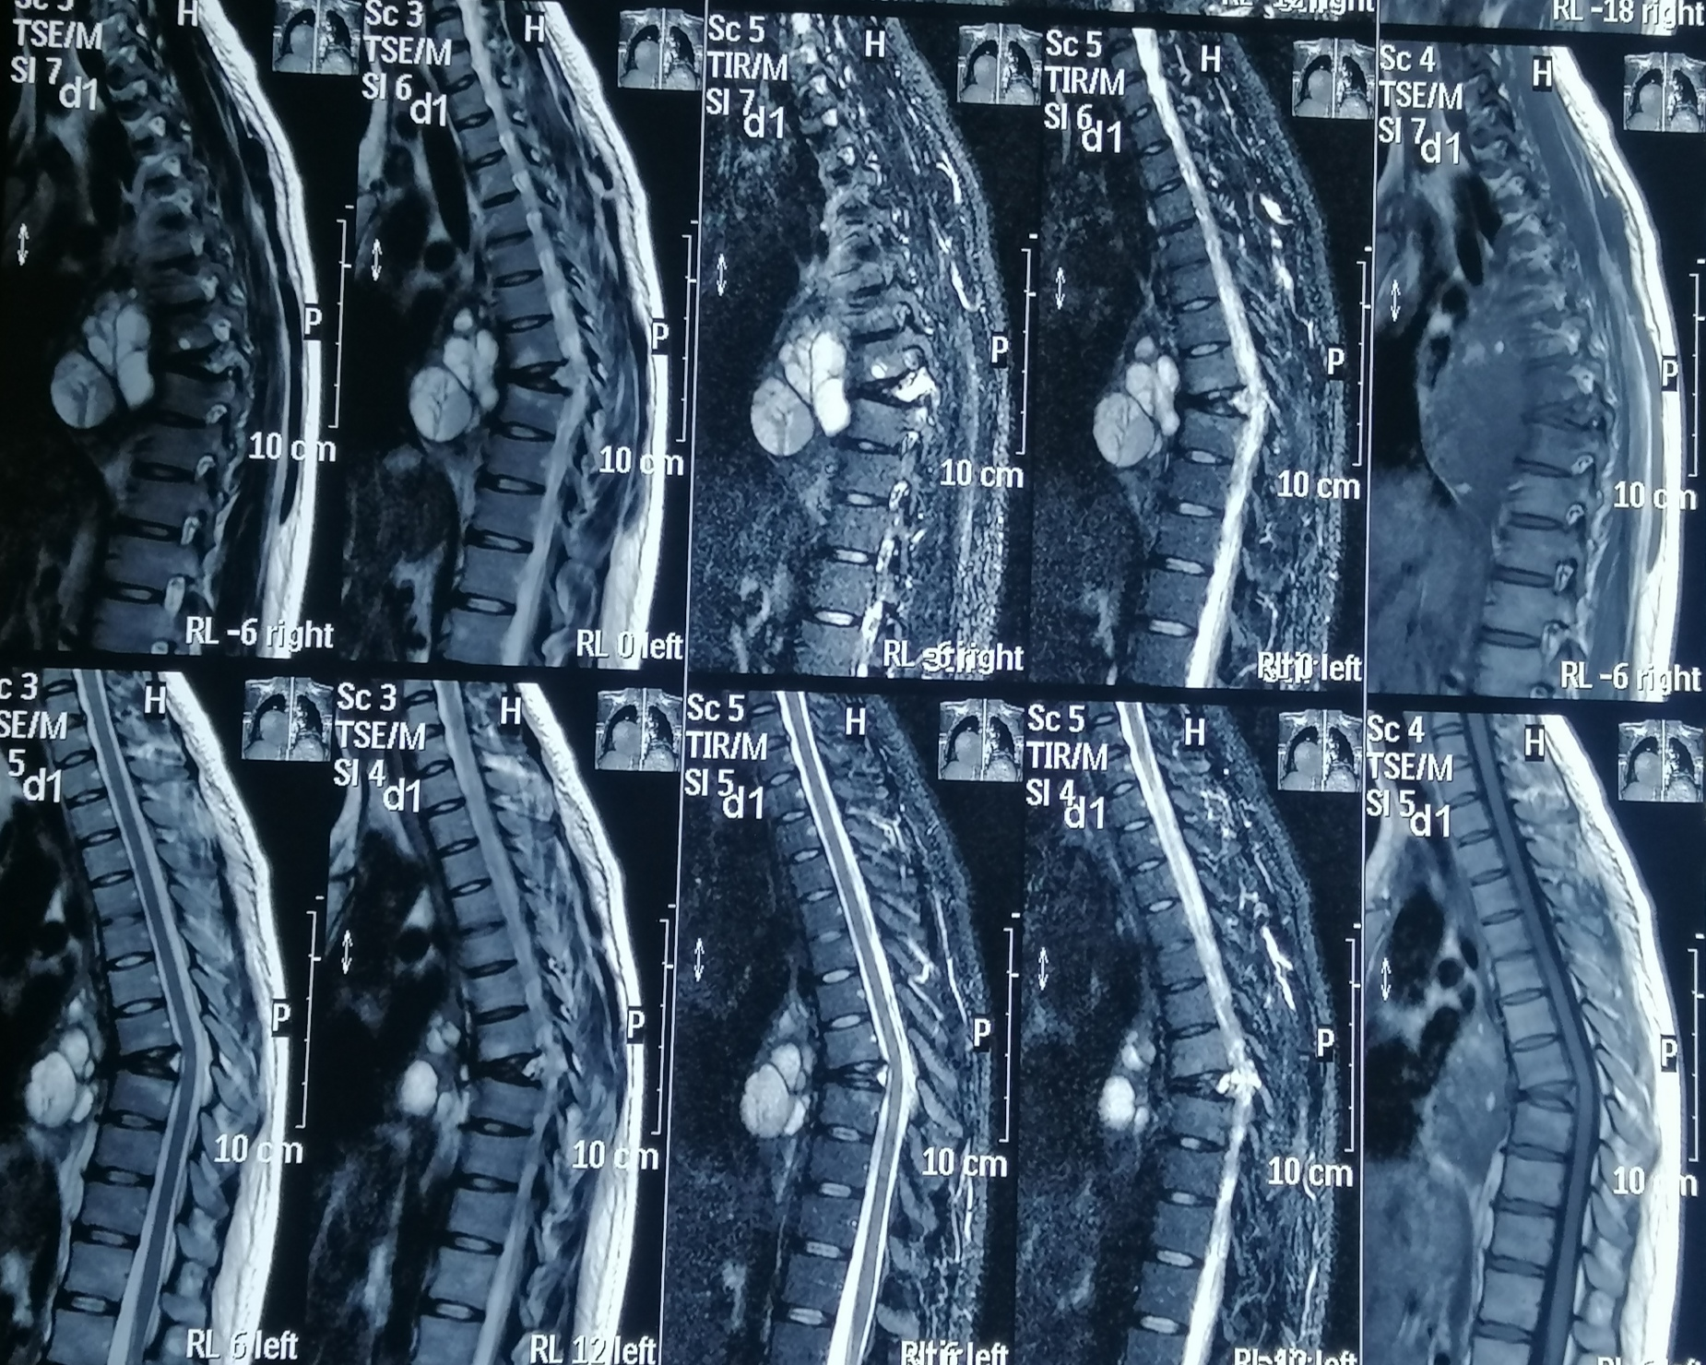

Slide 25
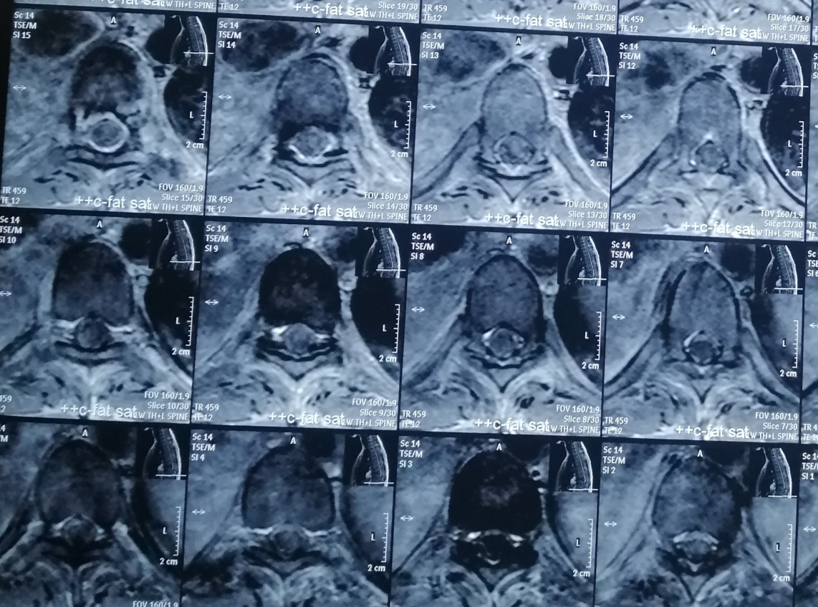

Slide 26
Treatment was initiated with Denazomab 120mg SC according to the protocol.
She received it on days 1,8,15, then after 4 weeks.

Slide 27
24/11/2019

Slide 28
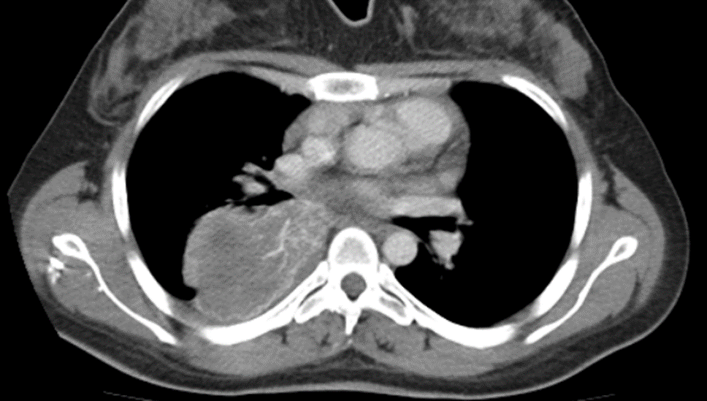
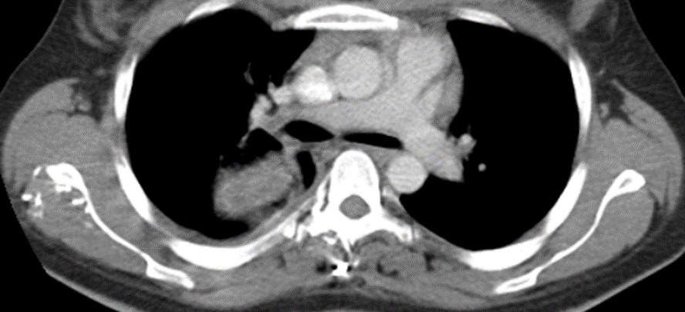
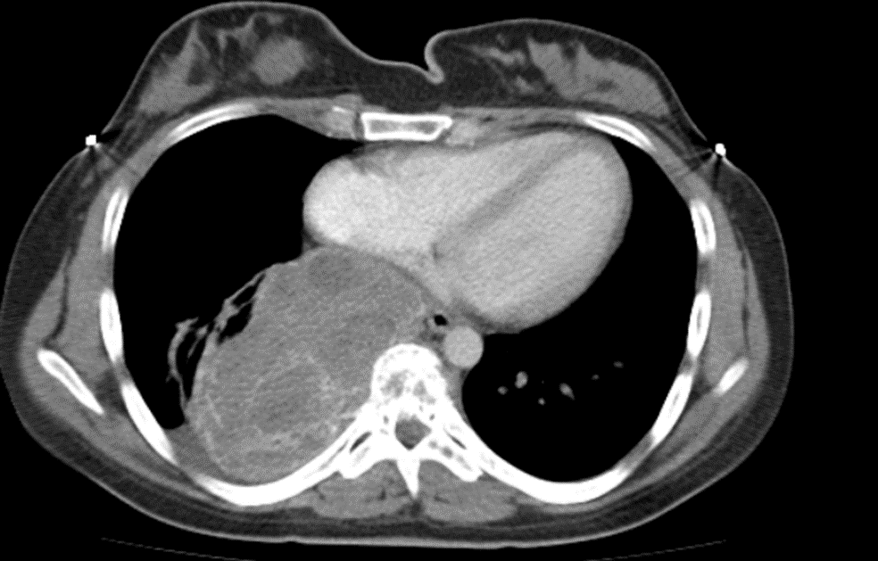
24/11/2019

Slide 29
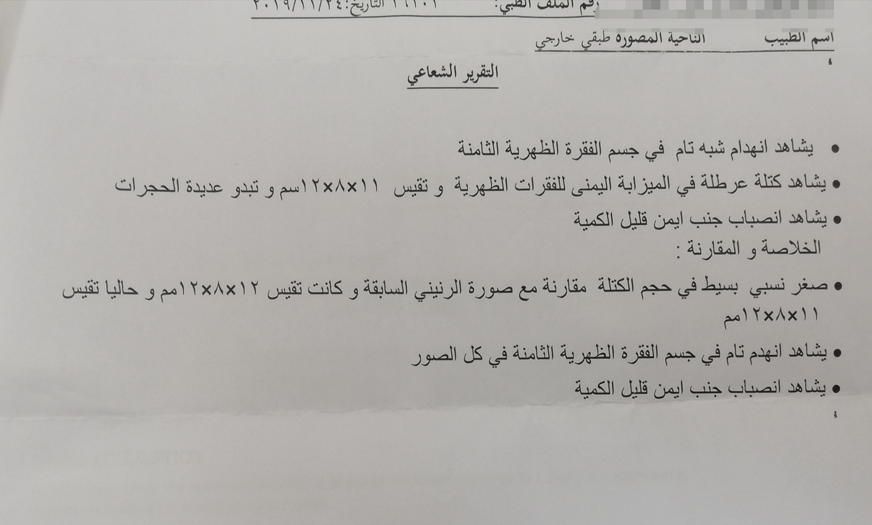

Slide 30
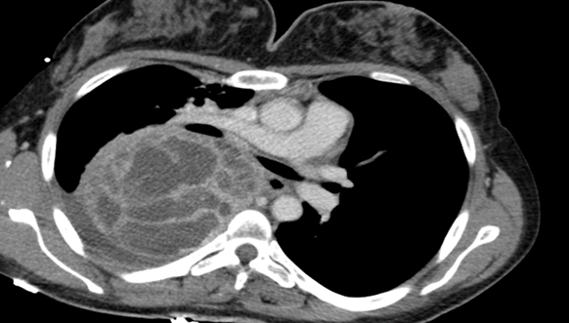
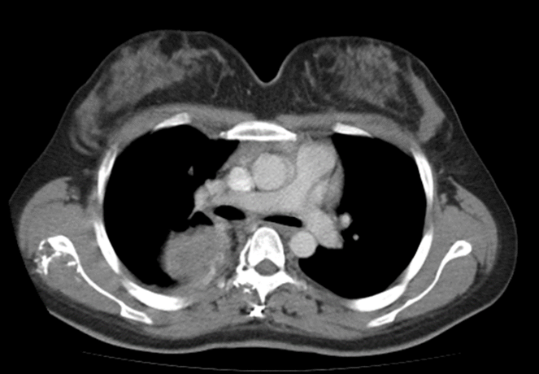
24/11/2019 7/9/2019

Slide 31
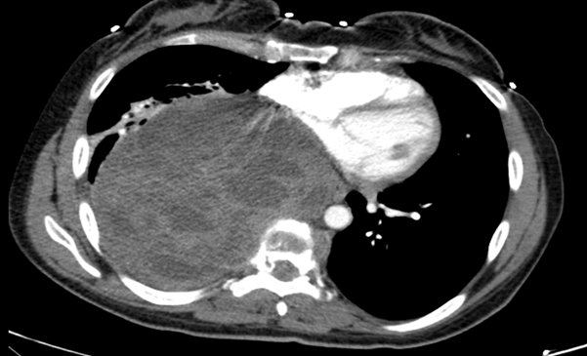
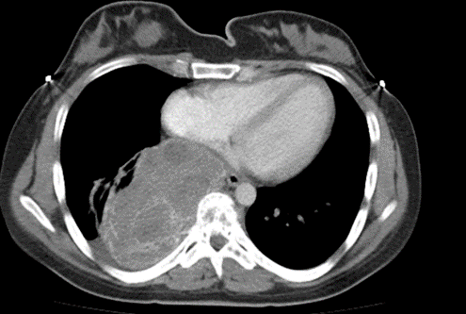
24/11/2019 7/9/2019

Slide 32
The girl underwent surgical removal of the giant mediastinal mass as well as the infiltrated vertebrae with internal fixation of the thoracic spinal vertebral column.

Slide 33
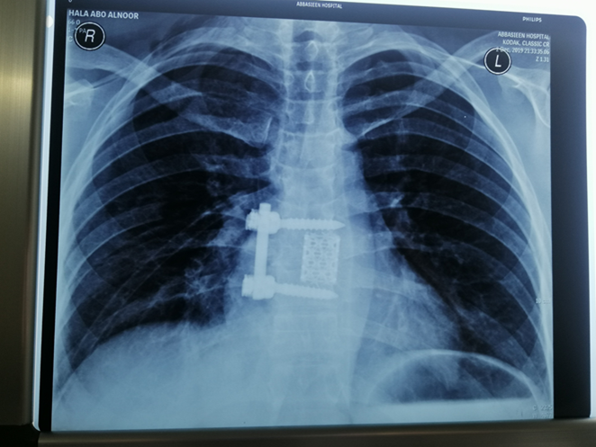

Slide 35
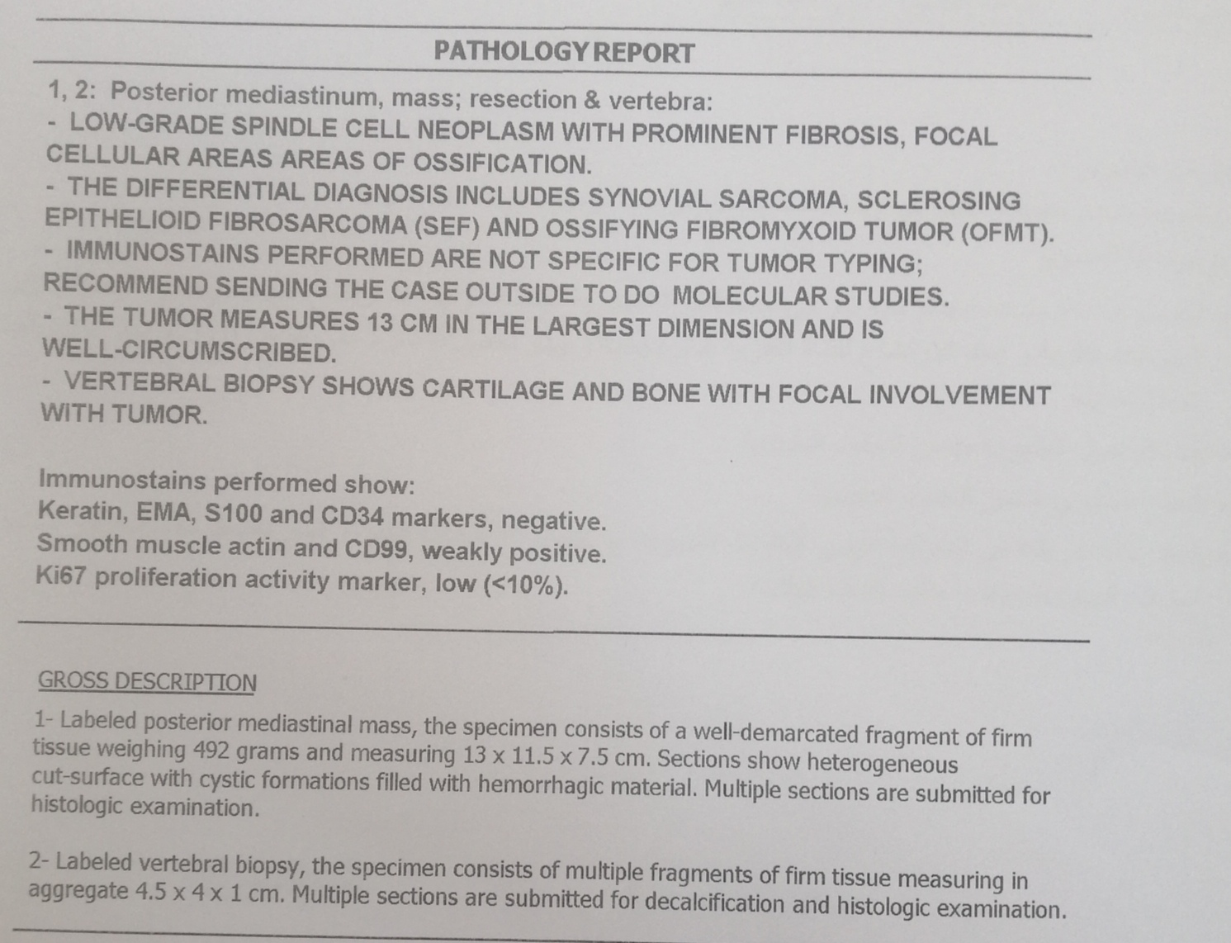

Slide 36
Low grade spindle cell neoplasm with prominent fibrosis,focal cellular areas of ossification.

Slide 37
Immunostains performed show: Keratin,EMA,S100 and CD34 markers negative.

Slide 38
Immunostains performed show: Keratin,EMA,S100 and CD34 markers negative. Smooth muscle actine and CD99,weakly positive.

Slide 39
Immunostains performed show: Keratin,EMA,S100 and CD34 markers negative. Smooth muscle actine and CD99,weakly positive. Ki67 proliferation activity marker low

Slide 40
Immunostains performed are not specific for tumor typing ,recommended sending the case outside to do moleculare studies.

Slide 41
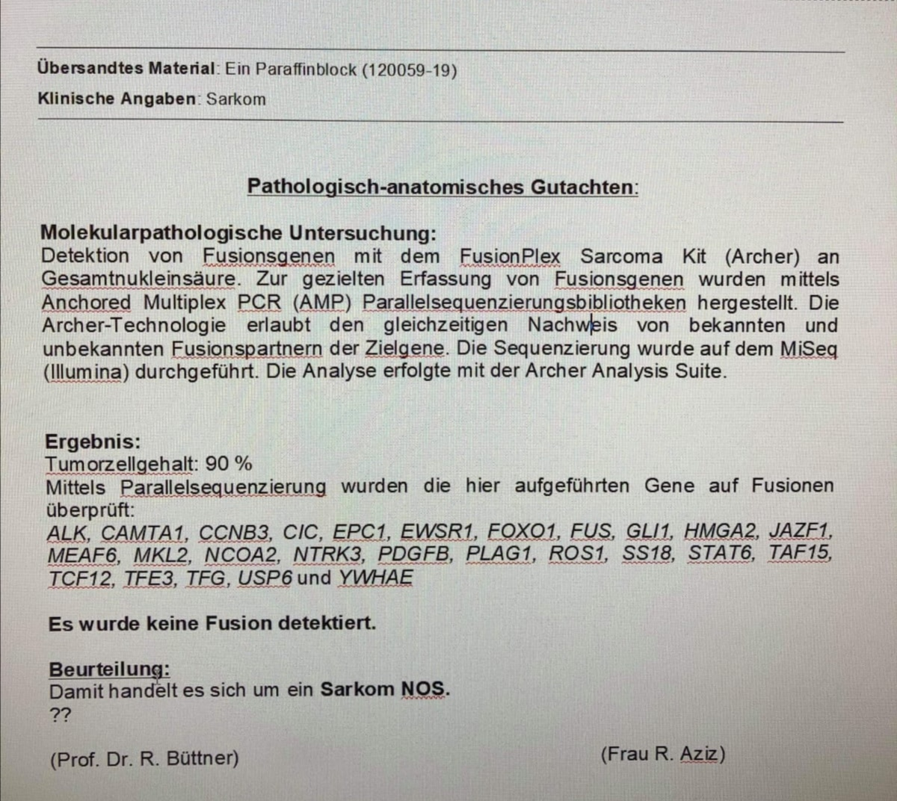

Slide 42
Fusion gene , PCR , Real sequencing
Sarcma NOS

Slide 43
What is the next step!!

Slide 44
What is the next step!! What about RT !

Slide 45
What is the next step!! What about RT ! Is there any adjuvant or maintenance therapy!

Slide 46
Thank you for your attention.

