Slide 1
Basics of Malignant Melanoma Management
Dr Malek Alhamidi
Mar 5, 2020

Slide 2
More melanoma patients will be diagnosed in the future
Melanoma incidence is increasing in men more rapidly than any other malignancy and in women more rapidly than any other malignancy except lung cancer
Between 2002 and 2006 the incidence of melanoma increased at an overall rate of 33% for men and 23% for women
The guidelines of melanoma management continue to change dramatically
NCCN guidelines version 1.2020

Slide 3
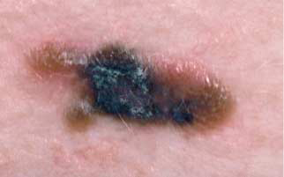
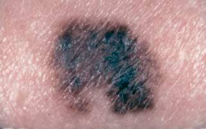
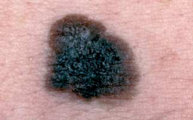
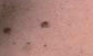
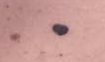
Melanoma Features
The criteria are asymmetry, borders, color, diameter ≥5 mm, and evolving over time (ABCDE)^{1,25}
The criteria were developed for easy identification of the physical characteristics of melanoma²⁵
  Less common features include itching, bleeding,
  skin breakdown, pain, or lump²⁶
Feature development in melanoma is generally
over months²⁷
The ABCDE criteria for evaluating
suspicious lesions
(adapted from Garbe C, et al and Abasi NR, et al)^{1,25}
Asymmetry of lesion
Irregular Border
Symptom (N=369) | Frequency (%)
Change in size | 51
Change in color | 40
Bleeding | 26
Itch | 22
Skin breakdown | 18
Pain | 7
Lump | 23
Variability in color
Diameter ≥5 mm
Common melanoma symptoms.²⁶
Evolving over time
ABCDE = asymmetry, borders, color, diameter
≥5 mm, and evolving over time.
1. Garbe C, et al. Eur J Cancer 2010;46:270–83.
25. Abbasi NR, et al. JAMA 2004;292:2771–6.
26. Negin BP, et al. Cancer 2003;98:344–8.
27. Clinical Practice Guidelines for the Management of Melanoma in
Australia and New Zealand. Available from www.nhmrc.gov.au
(last accessed February 11, 2011).

Slide 4
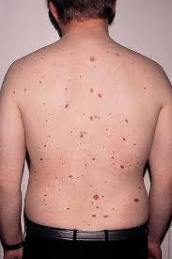
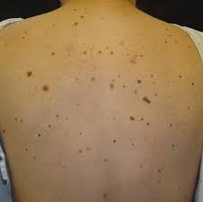
Dysplastic Nevus Syndrome

Slide 5

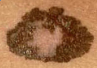
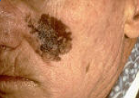
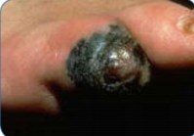
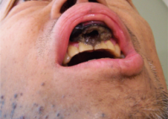
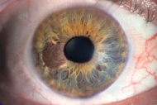
Histological Growth Patterns
Melanomas are categorized anatomically and histologically
  The subtypes of melanoma have varying incidence and prognosis
Risk Factor | Cutaneous |  |  |  | Mucosal | Uveal
 | Nodular | Superficial Spreading | Lentigo Maligna | Acral Lentiginous
Anatomic location | Any skin site | Any skin site | Head/neck | Palms, soles, subungual | Sinus, nasal, oral, anal, vulvar, vaginal, urethral mucosa | Iris, ciliary body, choroid
Incidence | Increasing | Increasing | Increasing | Stable | Stable | Stable
Trend in ethnic incidence | Highest in C, equal in AA and As | Highest in C, equal in AA and As | Highest in C, equal in AA and As | No trend | No trend | Highest in C; As higher than AA
Clinical features | Typically diagnosed at later stage | Typically diagnosed at earlier stage | Typically diagnosed at earlier stage Low metastatic potential | Typically diagnosed at later stage | Typically diagnosed at later stage | Typically diagnosed in the intraocular-only stage Preferentially metastasize to liver
Abbreviations: AA = African American; As = Asian; C = Caucasian.
5. Woodman SE, et al. Biochem Pharmacol 2010;80:568–74.
6. Four types of melanoma. Available from www.skincarephysicians.com (last accessed April 20, 2011).
7. Seetharamu N, et al. Oncologist 2010;15:772–81.
Anatomical and histological melanoma categorization.^{5–8}
8. The Liverpool Ocular Oncology Centre, Royal Liverpool University Hospital. Available from www.eyetumour.co.uk (last accessed March 2, 2011).

Slide 6

Principles of biopsy of a suspicious pigmented lesion
Excisional biopsy with 1 to 3 mm margins is preferred. Avoid wider margins to permit accurate subsequent lymphatic mapping
Full thickness incisional or punch biopsy of clinically thickest or most atypical portion of lesion is acceptable in certain anatomic areas (eg: sole/palm, digit face ear) or for very large lesions

Slide 7
Stage III with clinically positive LN/M0
Wide excision of the primary site with therapeutic lymph node dissection TLND
In the setting of inguinal lymphadenopathy a pelvic dissection if
PET-CT or pelvic CT-scan reveals iliac and/or obturator lymph node involvement
A positive Cloquet′s LN is found on intra-operative frozen section
3 or more inguino-femoral lymph node involved
Notes:
cloquet's node is the name of the top-most deep inguinal lymph node, which is located below the inguinal ligament. These nodes drain first to the body's external iliac lymph nodes, second to the pelvic lymph nodes, and finally to the paraaortic lymph nodes

Slide 8
Stage III with clinically positive LN/M0
Adjuvant nivolumab significantly improve RFS but its impact on OS has not been yet reported
Adjuvant pembrolizumab significantly improve RFS but its impact on OS has not been yet reported
Adjuvant dabrafenib/trametinib for patients with BRAF V600E mutation
Adjuvant radiotherapy

Slide 9
Stage III with clinical or microscopic satellite/in-transit metastasis:
Limited resectable disease
Wide excision of the primary site with therapeutic lymph node dissection TLND
Adjuvant nivolumab significantly improve RFS but its impact on OS has not been yet reported
Adjuvant pembrolizumab significantly improve RFS but its impact on OS has not been yet reported
Adjuvant dabrafenib/trametinib for patients with BRAF V600E mutation
Adjuvant radiotherapy

Slide 10
Stage III with clinical or macroscopic satellite/in-transit metastasis:
Unresectable disease
Use systemic therapy

Slide 11
Metastatic limited (resectable) melanoma
2 options
Resection then systemic therapy
Systemic therapy

Slide 12
Metastatic melanoma: Systemic therapy

Slide 14
Systemic therapy for metastatic melanoma
BRAF/MEK inhibitors: for BRAF V600 mutation:
Dabrafenib/trametinib
Vemurafenib/cobimetinib
Oncorafenib/binimetinib
Checkpoint inhibitors: effective regardless of BRAF mutation status
Anti PD-1: nivoluman, Pembrolizumab
Anti TCLA-4: ipilimumab
Imatinib: for activating KIT mutations
Cytotoxic chemotherapy

Slide 15

BRAF/MEK inhibitors for metastatic melanoma
BRAF/MEK inhibitor combination therapy was associated with improved response rate, PFS, and OS compared to BRAF inhibitor monotherapy, as well as a similar or better toxicity profile
If BRAF/MEK inhibitor combination is contraindicated, BRAF inhibitor monotherapy with vemurafenib or dabrafenib are recommended options, especially in patients who are not appropriate candidates for checkpoint immunotherapies
Patients treated with BRAF targeted therapy as first line therapy who achieved maximum clinical benefit (but not complete remission), a switch to immune check inhibitor may be considered
Notes:
Maximum clinical benefit: no additional tumor regression on at least 2 consecutive scans taken at least 12 weeks apart

Slide 16
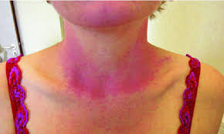
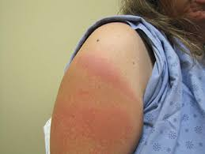
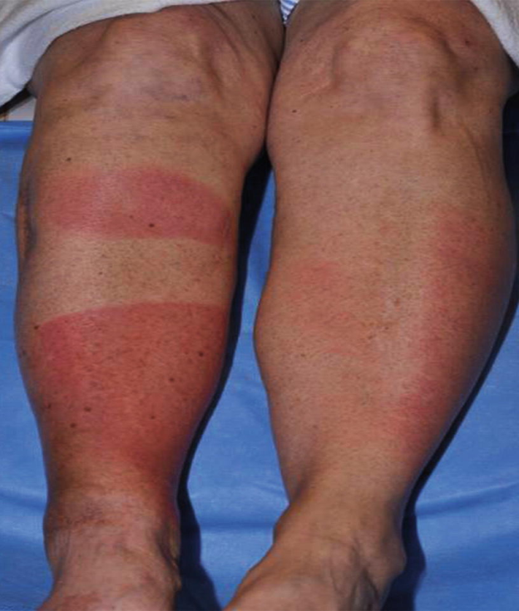
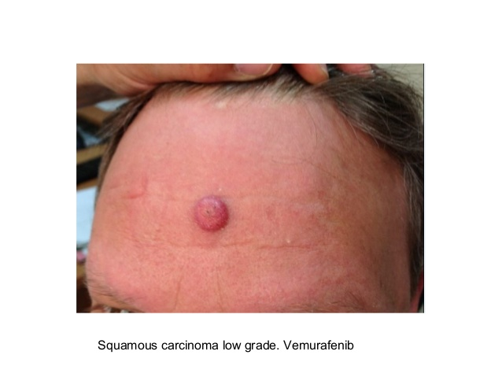
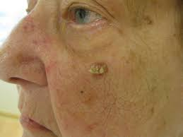
Toxicities associated with targeted therapy
Dermatologic:
BRAF inhibitors are associated with:
Squamous cell carcinoma
Extreme photosensitivity
Occur much less often with BRAF/MEK inhibitors

Slide 17
Toxicities associated with targeted therapy
Pyrexia:
55% of BRAF/MEK combination patients
20% of BRAF inhibitors monotherapy patients
Episodic
The onset is often 2 to 4 weeks after start of treatment
Median duration 9 days
May be associated with chills, night seats, dehydration, electrolyte abnormalities, and hypotension

Slide 18
Toxicities associated with targeted therapy
Pyrexia:
Stopping or holding BRAF/MEK inhibitors will often interrupt the episode
Treatment can be resumed with full dose upon cessation of pyrexia and pyrexia related symptoms
Upon re-exposure to BRAF/MEK inhibitors repeat pyrexia events can occur but grade> 3 events are uncommon (21%)
If prolonged or severe pyrexia not responsive to BRAF/MEK inhibitors discontinuation, low dose steroid (prednisolone 10 mg) can be used
Antipyretics as needed and increase fluid intake

Slide 19
Chekpoint inhibitors for metastatic melanoma
Anti PD-1: nivolumab, Pembrolizumab
Anti TCLA-4: ipilimumab

Slide 20
Selection of subsequent systemic therapy
Factors affecting selection of subsequent systemic therapy:
Response and toxicities on prior therapies
Rate of progression of the underling disease (symptomatic or not)
Presence or absence of CNS progression
Performance status
Patient preference and compliance

Slide 21
Selection of subsequent systemic therapy
Anti PD-1 and anti TCLA-4 are not considered the same class of agent because they target different molecules
Therefor patient who received first line ipilimumab, subsequent treatment with anti PD-1 therapy is a recommended option, and vice versa
Patient who experience disease control (CR, PR, SD) and have no residual toxicity, but subsequently experience disease progression/relapse > 3 months after treatment discontinuation, re-induction with the same agent or same class of agent may be considered

Slide 22

Metastatic melanoma with activating KIT mutations
Mucosal melanoma
Acral melanoma
Chronically skin damaged melanoma

Slide 23
Metastatic Melanoma: Cytotoxic Therapy
Dacarbazin
Paclitaxel/carboplatin
Paclitaxel
Albumin bound paclitaxel
Temozolamide
Cisplatin/vinblastine/dacarbazin

Slide 24
Metastatic melanoma with brain metastases
Priority to prevent or delay intratumoral hemorrhage, seizures, and neurologic dysfunction
Treatment is based on symptoms, number of lesions, location of lesions, presence of extracranial metastases…….
WBRT
Resection may be un option in highly selected patients
After treatment of the brain, options for manaegement of extracranial sites are the same as for patients without brain metastases
HD interlukin-2 is contraindicated: low efficacy, worsen edema
Caution: concurrent or sequential BRAF targeted therapy and radiation: potential for increased toxicity

