Slide 1
The systematic treatment of STS
Dr Nidal KHEDER
Head of departement of oncology
Ibn alnafis Hospital – Damascus
05-03-2020

Slide 7
Management in localized disease

Slide 10
Management in advanced disease

Slide 19
conclusion
Rare
heterogeneous (more than 80 subtype)
localized disease MDT ..surgery +\- RT +\- CT .
Advanced disease : first line … Doxorubucin +\-Ifosfomide ….second line and beyond …Taxanes …GMS ….Dacarbazine … Trabectedine (LMS & LPS ) , …. Eribulin (LPS) , Pazopanib ( all subtypes except LPS ) .
Subsequent treatments are tailored by tissue subtypes.
Immunotherapy ?!

Slide 20
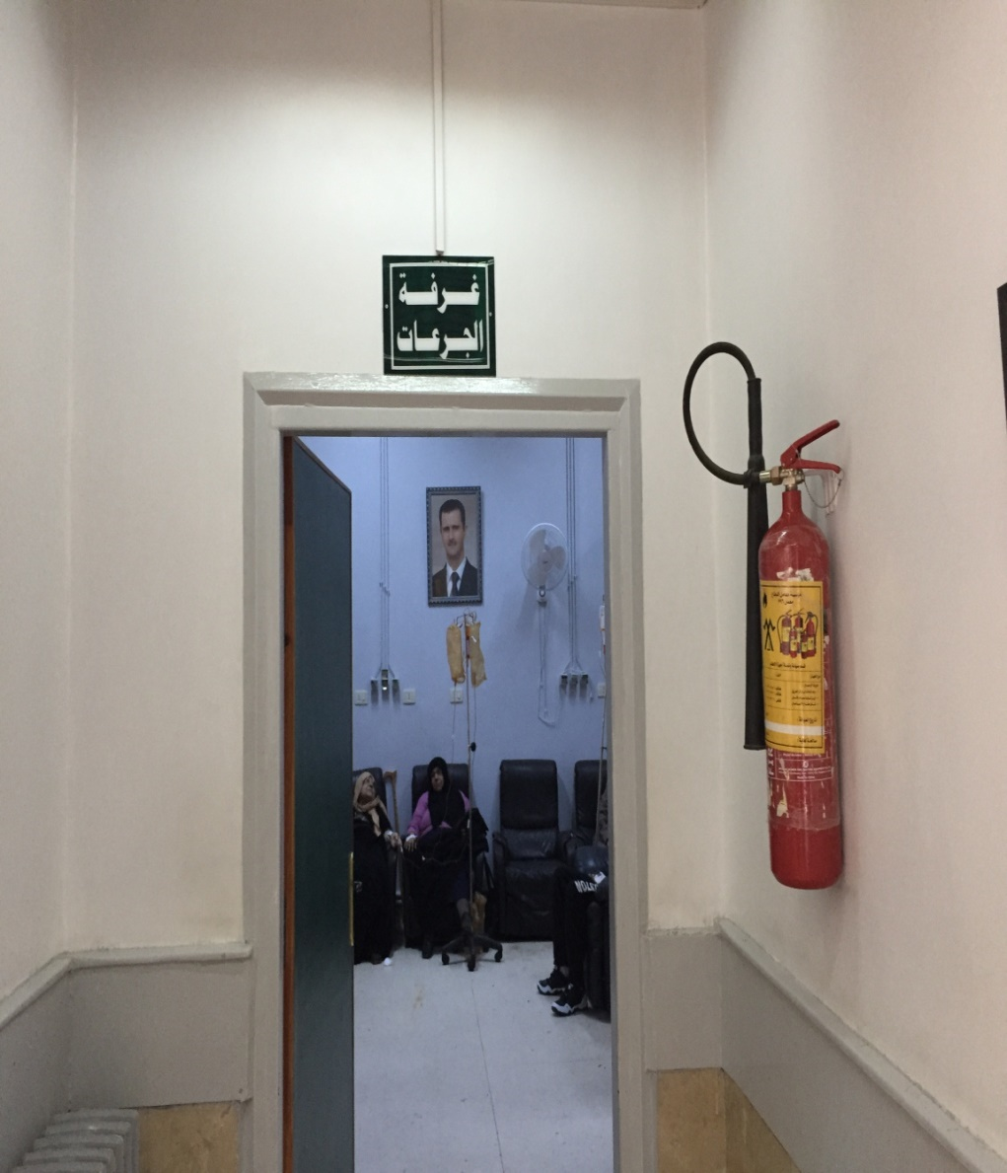
Thank you for your attention

